Slide 1
Boundary Condition Analysis Pt 3 – Case Studies
CE 547 – BRIGHAM YOUNG UNIVERSITY

Slide 2
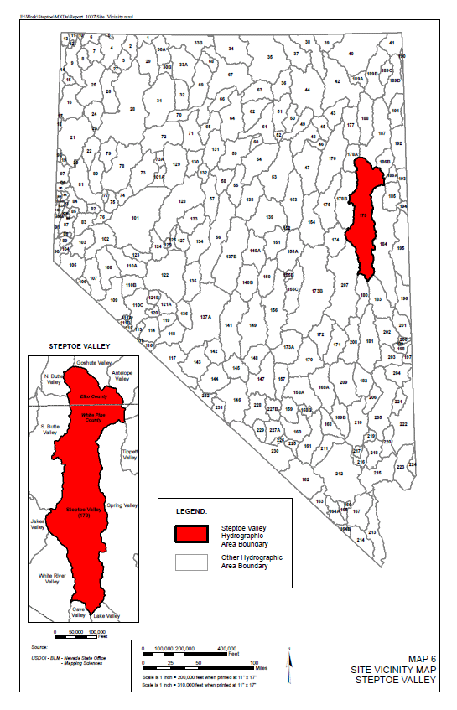
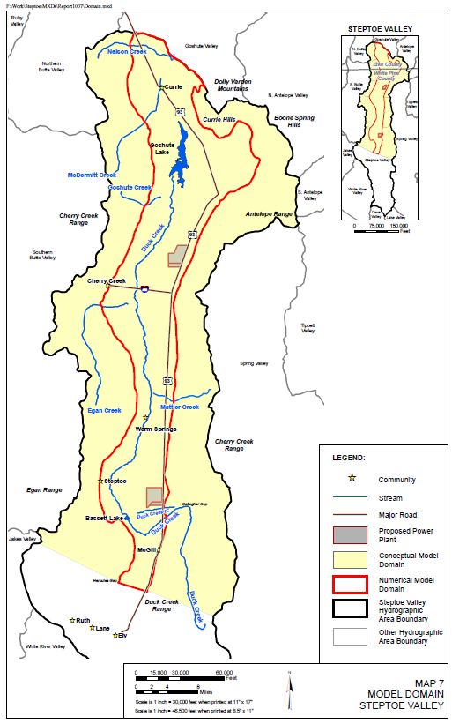
Steptoe Valley Model – Nevada Power

Slide 3
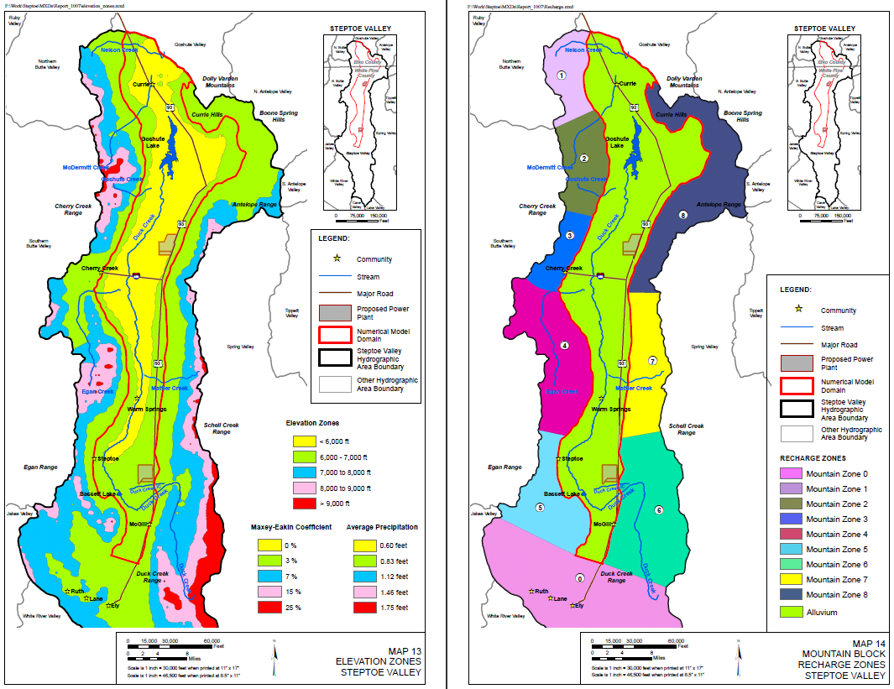
Steptoe Valley Model – Nevada Power
Specified Head
Lateral Inflow

Slide 4
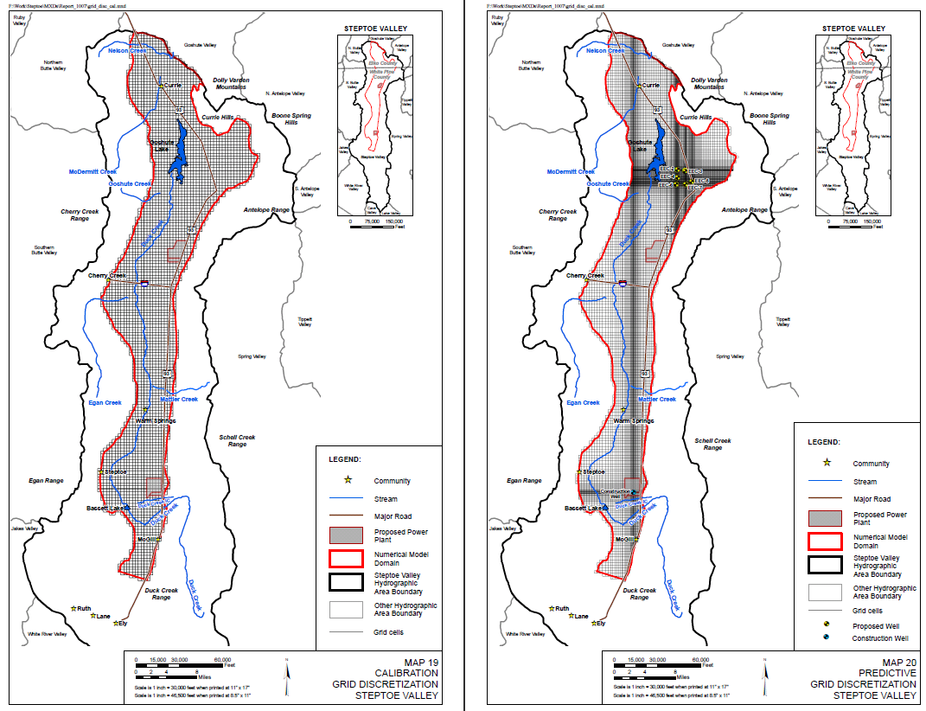
Steptoe Valley Model – Nevada Power

Slide 5
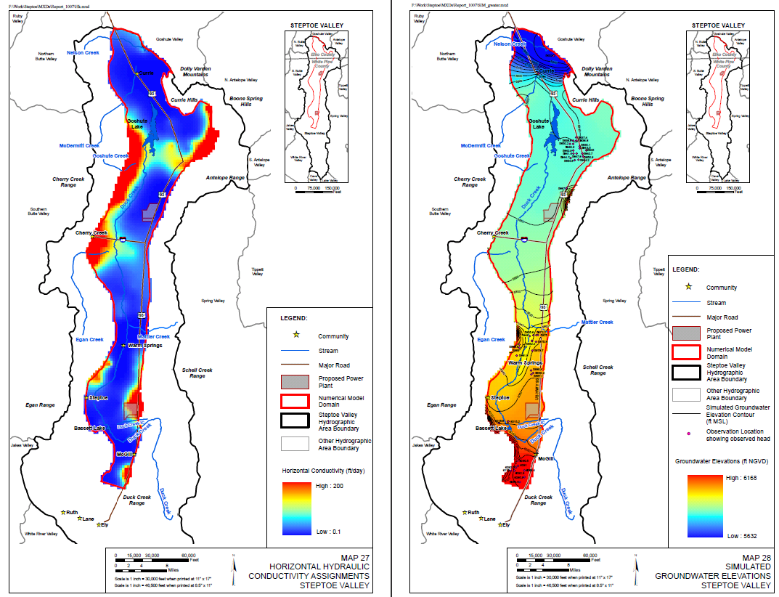
Steptoe Valley Model – Nevada Power

Slide 6
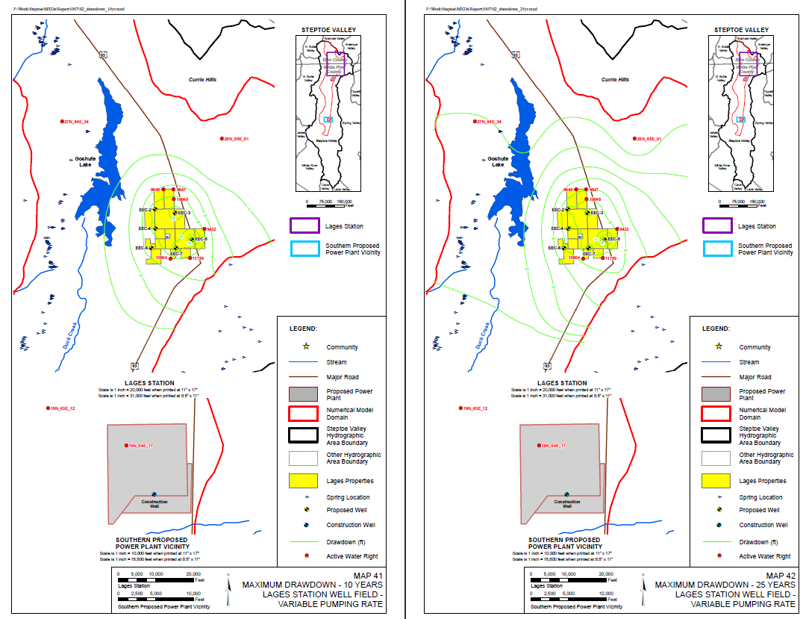
Steptoe Valley Model – Nevada Power

Slide 7
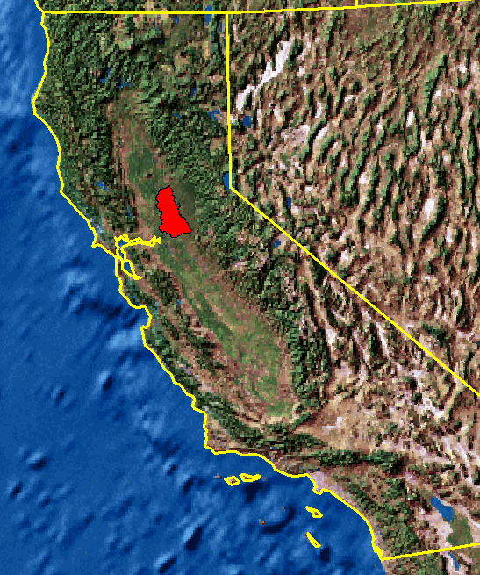
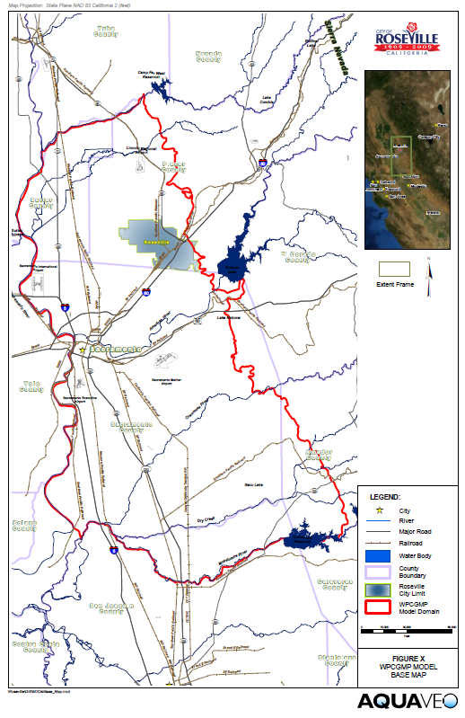
Roseville/Sacramento ASR Model

Slide 8
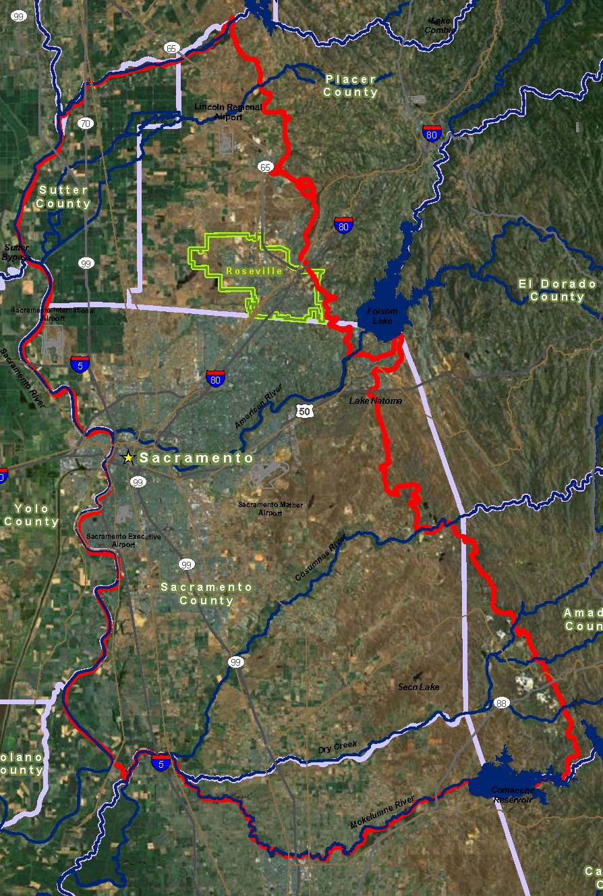
Model Boundaries
Bear River
Sierra Nevada
Feather River
Combination of no-flow and specified flow boundaries representing runoff from ungaged watersheds in Sierra Nevada Mtns.
Sacramento River
Mokelumne River

Slide 9
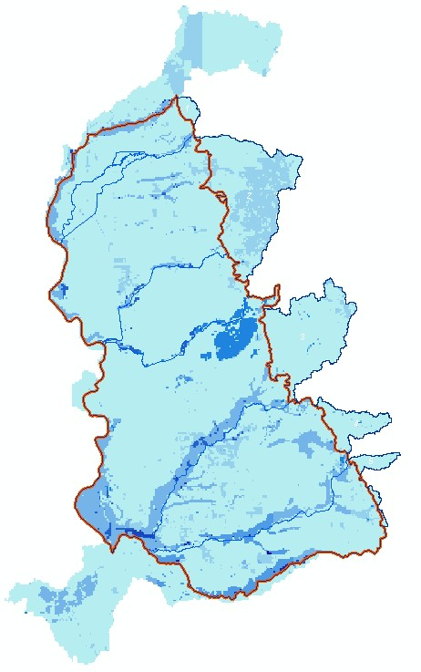
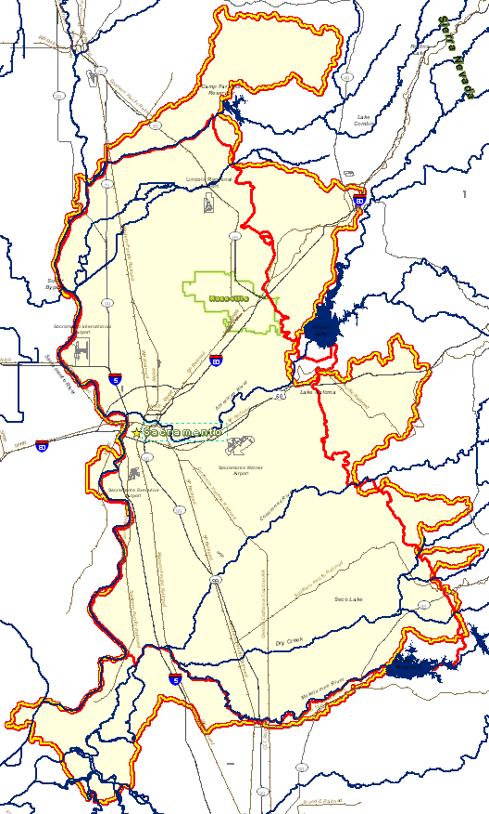
Ungaged Watersheds
Runoff calculated using the GSSHA surface water model
Runoff applied as lateral inflow boundary condition
1
2
3
4
5
6
7

Slide 10
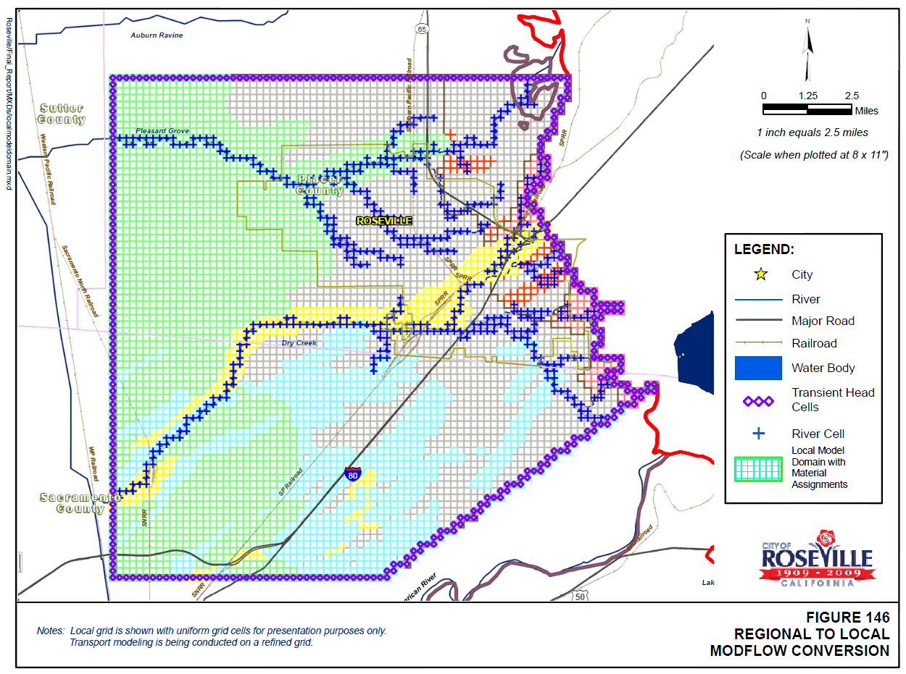
Local Scale Model

Slide 11
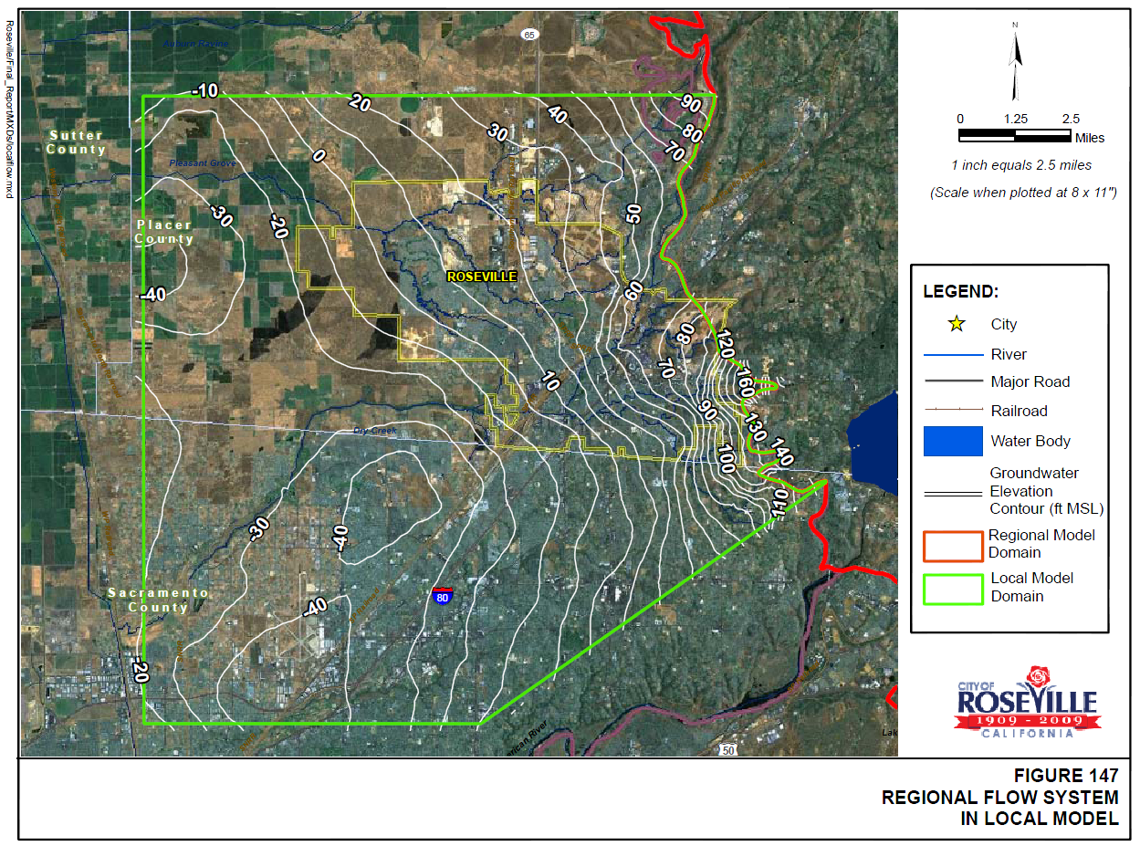
Local Scale Model

